Slide 1
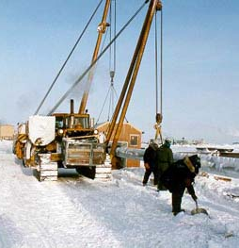
THE NORTH AMERICAN FRONTIER:
ARCTIC GAS AND MORE
NEMS/AEO 2001 Conference
Washington – March 27, 2001
Roland R. George
Principal
rrgeorge@purvingertz.com
www.purvingertz.com

Slide 2
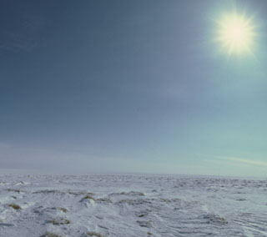
Objective of the Presentation
“To present Purvin & Gertz’ latest views
on Alaska North Slope and Mackenzie
Delta/Beaufort Sea natural gas supply.
The resource potential will be examined
and put in context of the market.
Some strategic considerations will
be highlighted.”

Slide 3
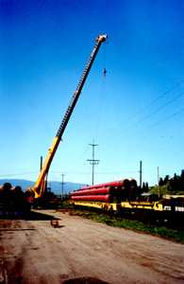
Outline of the Presentation
Objective of the Presentation
Overview of Upstream and Outlook
Findings on Arctic Gas
Summary and Conclusions

Slide 4
OVERVIEW OF UPSTREAM AND OUTLOOK

Slide 5
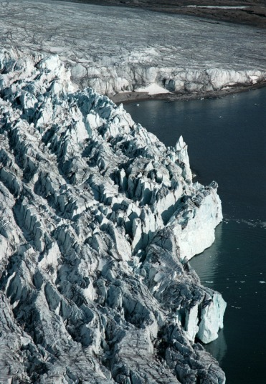
The Upstream Industry in Perspective
North America: largest gas market in world and strong growth outlook
Technical and cost efficiency gains mean increased competitiveness for gas
Major supply potential still exists in conventional areas as well as in frontier areas
Some areas are reaching maturity; so what’s the next new major increment of supply? The Arctic!

Slide 6
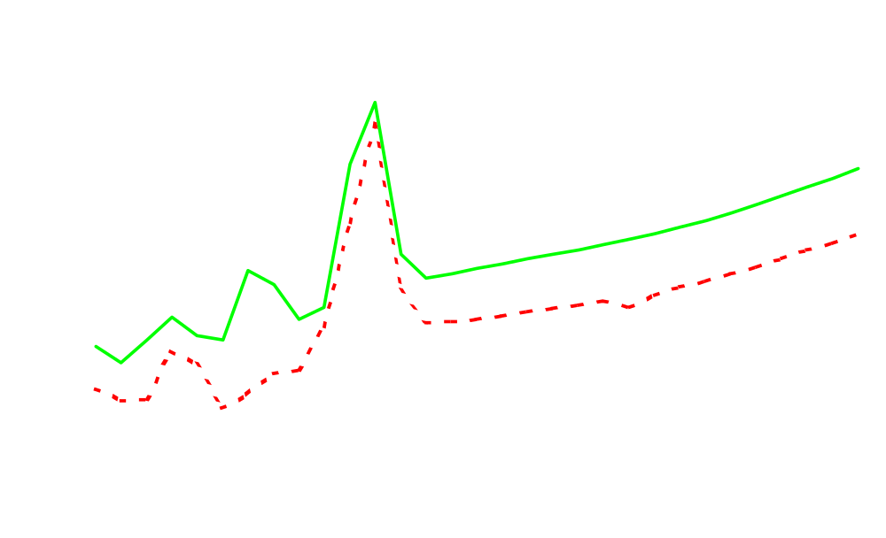
Natural Gas Pricing (Current Dollars)
Current $U.S./MMBtu
Henry Hub
AECO

Slide 7
Technically Recoverable Resources (TCF)
U.S. Natural Gas Resource
Nonass. Undiscovered | 319
Nonass. Inferred | 244
Unconventional | 393
Associated | 129
Alaska Proved | 33
Proved Reserves | 164
Total Natural Gas | 1,281
Source: EIA Assumptions to Annual Energy Outlook 2001.

Slide 8
Other Resource Estimates (TCF)
NPC (Total Remaining Gas Resources)
Lower 48 | 1,466
Alaska | 322
Canada | 667
Potential Gas Committee (Gas Resources)
Lower 48 (probable, possible, speculative) | 702
Alaska | 194
Coal-bed methane | 141
 | 1,037

Slide 9
Potential Gas Resource (TCF)
 | Remaining Discovered | Undiscovered Resource | Total Remaining Potential
Canada⁽¹⁾ | 95 | 535 | 630
Lower 48 | 411 | 1137 | 1548
Source: NEB, Supply and Demand to 2025.
Note: (1) Mackenzie/Beaufort: 9 TCF discovered, 55 TCF undiscovered

Slide 10
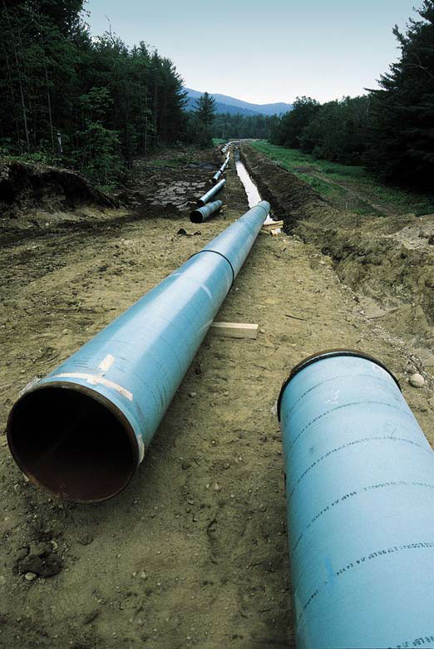
Why is ANS and Mackenzie Delta Gas Next?
“Out-of-bounds” gas
(e.g. offshore B.C., California, Florida)
Too far, too speculative
(e.g. Arctic Islands)
Mexico (upstream closed)
LNG (niche only)
Coal-bed methane (maybe)

Slide 11
Incremental Lower 48 Supply * - BCF/D
Net Imports from Canada
2010: 3.4
2020: 5.7
Mountain
2010: 4.0
2020: 11.9
Other Lower 48
2010: -0.2
2020: 0.1
Other Net Imports
2010: 0.2
2020: 0.6
TX/LA
2010: 8.0
2020: 8.2
Net Exports to Mexico
2010: 0.8
2020: 0.7
Note: * Compared to 2000

Slide 12
FINDINGS ON ARCTIC GAS

Slide 13
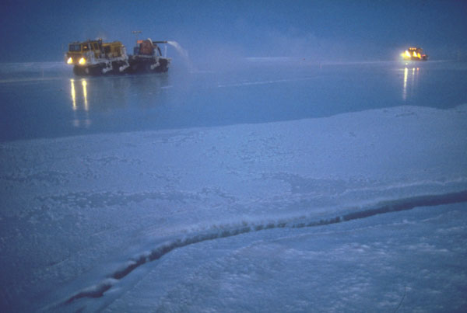
Current Drivers for Arctic Gas Development
Concerns over current and future gas supply with consequent increase in price
Strong long-term gas demand outlook
Drive to monetize stranded gas assets with impressive and economic potential
Strong stakeholder support
Notes:
3

Slide 14
Northern Areas of Recent or Potential Interest
U.S. Chukchi
U.S. Beaufort
Prudhoe Bay
Other Offshore
Other Onshore
Mackenzie Delta/
Beaufort Sea
Eagle Plains
Cook Inlet
Peel Plateau
Colville Lake
Norman Wells
Liard Plateau
Cameron Hills
Notes:
4

Slide 15
Alaskan Gas Development Options
North Slope (Pipe, GTL)
3
Mackenzie Delta
1
6
2
5
(LNG/
GTL)
1
4
South Shore
2
LEGEND
1
TransAlaska Route
2
Alaska Highway Route
3
Beaufort Subsea Route
4
Mackenzie River Valley Route
5
Dempster/Klondike Highway
6
Porcupine River Route
Proposed Pipelines
Existing Pipelines
Notes:
4

Slide 16
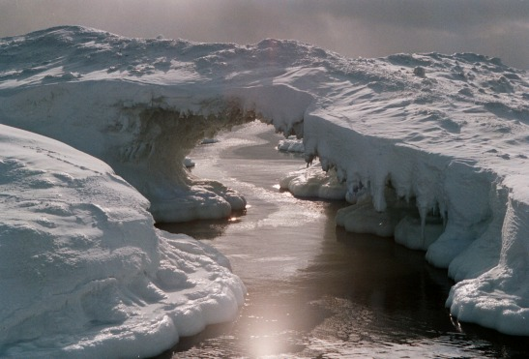
General Conclusions from Purvin & Gertz’ Studies
ANS and Mackenzie Delta gas could be developed within a decade
Henry Hub price of less than 3.00 $/MMBtu (constant 2001$) could be adequate to develop discovered resources if most economic development option chosen
Project costs and market prices are the greatest quantifiable risk factors

Slide 17
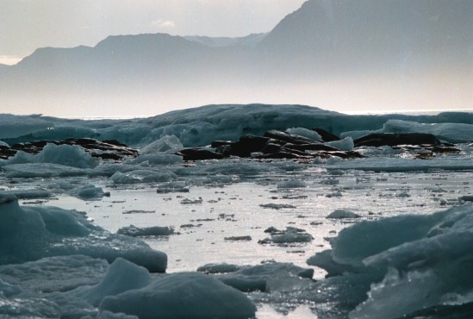
Show Stoppers?
Potential show stoppers on the political, economic, social, technological, environmental, and regulatory fronts will likely all be overcome
Except maybe for the subsea route

Slide 18
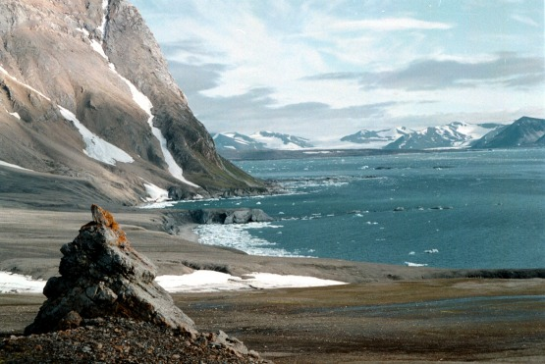
How Will Development Play Itself Out?
“The Big Y Solution”
“The Shortest Route Scenario”
“The Alaska Advantage Scenario”
Variations on a theme – competitive or synergistic development

Slide 19
SUMMARY AND CONCLUSIONS

Slide 20
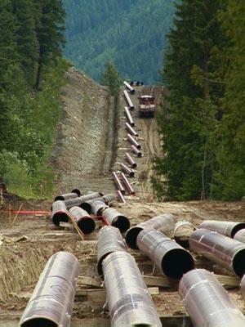
Summary and Conclusions
Strong gas demand growth will be satisfied by conventional and increasingly by frontier supply
Arctic gas is the next major increment of supply and will require major upstream investments
Arctic gas pipelines and takeaway capacity out of Western Canada represent major business and investment opportunities

Slide 21

“Purvin & Gertz is an independent, employee
owned, international energy consulting firm
providing sound and objective strategic, commercial,
and technical advise to the energy sector.”
.
INTERNATIONAL ENERGY CONSULTANTS
www.purvingertz.com

